Slide 1

Take Note App
Phu Tai Duong
213536911

Slide 2
Introduction
The Taking Note App can help the users can take some note when they need. After the couple of simple steps, they can easily store the information which they have to remember. They also can find and edit notes after they added. The app works on the Android platform.

Slide 3
Features
Adding note
Editing note
Search note

Slide 4
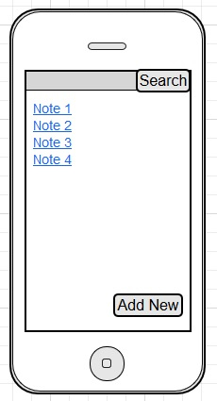
Mockup
Main Page

Slide 5
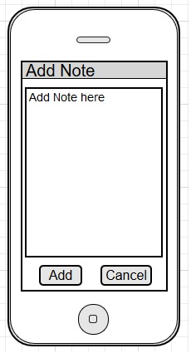
Mockup
Adding Page

Slide 6
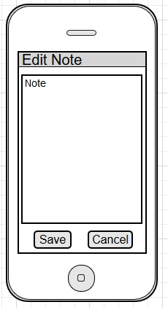
Mockup
Editing Page

Slide 7
Thank for watching

